Slide 1
Loan Prediction
Team Members
Manjeet Singh - 19BCS006
Serjeel Ranjan - 19BCS009
Raghav - 19BCS119

Slide 2
INTRODUCTION
Our goal is to predict the approval of loan given the previous historical data. The data covers all urban, semi-urban and rural areas. The user can can give his loan history data in detail and the loan eligibility can be predicted in real time.
These details are Gender, Marital Status, Education, number of Dependents, Income, Loan Amount, Credit History, and others.
We are going to do a Binary Classification problem in which we need to predict our Target label which is “Loan Status”.

Slide 3
INTRODUCTION
We are going to do a Binary Classification problem in which we need to predict our Target label which is “Loan Status”.
Loan status can have two values: Yes or NO.
Yes: if the loan is approved
NO: if the loan is not approved
So using the training dataset we will train our model and try to predict our target column that is “Loan Status” on the test dataset.

Slide 4
Type of Problem
We are doing Binary Classification which is a supervised learning algorithm that categorizes new observations into one of two classes.
In machine learning, many methods utilize binary classification. The most common are:
Support Vector Machines
Naive Bayes
Nearest Neighbor
Decision Trees
Logistic Regression
Neural Networks
We have used Logistic Regression to predict our final result.

Slide 5
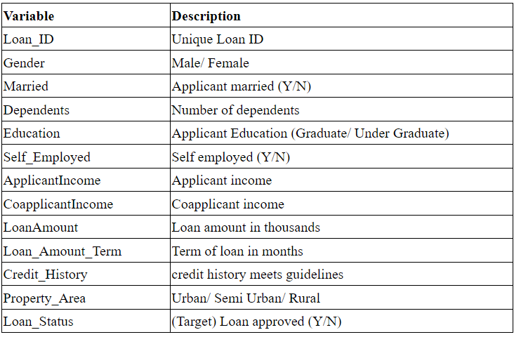
Dataset
So train and test dataset would have the same columns except for the target column that is “Loan Status”.
This is how the columns of data set looks like:-

Slide 6
Dataset
Source of Dataset - Kaggle
Link - https://www.kaggle.com/datasets/altruistdelhite04/loan-prediction-problem-dataset
Number of Rows - 931
Number of Attributes - 13
Training set % - 80%
Testing set % - 20%

Slide 7
Code
Google Collab - https://colab.research.google.com/drive/1yqGENefKHtbtwopelr0dlHhsK9zdw48Y#scrollTo=la-_uOKdYE0g

Slide 8
Conclusion
We have used multiple algorithms for training purposes like Decision Tree, Linear Discriminant Analysis, SVC, K neighbours classifier, Gaussian Naive Bayes and Logistic Regression.
Among all the algorithms logistic regression performs best on the validation data with an accuracy score of 82.7%.

Slide 9
Future Scope
The classifier built can be deployed on a web application and can be used by real customers with real data to predict home loans.

